Slide 1
18-349: Introduction to Embedded Real-Time Systems
Lecture 21: Wireless Communication
Anthony Rowe
Electrical and Computer Engineering
Carnegie Mellon University

Slide 2
Administrivia
Lab 4 due next Wednesday (Dec. 7th)
Redemption Lab due (Dec. 12th)
Final (Friday Dec. 16th 8:30-11:30am)

Slide 3

Overview
Motivation for Wireless
Wireless Challenges
Wireless MAC Principles
Example Technologies
IrDA
NFC
802.15.4
Zigbee
Bluetooth
WiFi
LTE
LP-WAN

Slide 4
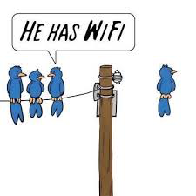
Why Wireless Communication?
Reduced Installation cost / weight
Airplanes / cars / building sensors etc
High Mobility
Cellphones, wearables, etc
Reconfigurable / Fault Tolerant
Double-edged sword

Slide 5
Wireless Challenges
Data Rate / Packet Loss (Physical Layer Issues)
Air is not as good of a medium as copper
Slow Fading / Fast Fading
Single Duplex Channel
Difficult to transmit / receive on same frequency
Broadcast Domain (collisions)
Hidden Terminal Problem
Exposed Terminal Problem
Near-Far Problem

Slide 6
Hidden Terminal
Node A and Node C transmit to Node B at the same time…
X
a
b
c

Slide 7
Exposed Terminal
Node B and Node C try sending to Node A and Node D respectively
Node B overhears Node C’s transmission and doesn’t send to avoid a collision…
Decrease in network throughput
X
a
b
c
d

Slide 8
Near-Far Problem
Node A and Node B often get a “fair” share of bandwidth
Since Node B is much slower it decreases Node A’s capacity
ap
1 Mbps
54 Mbps
b
a

Slide 9
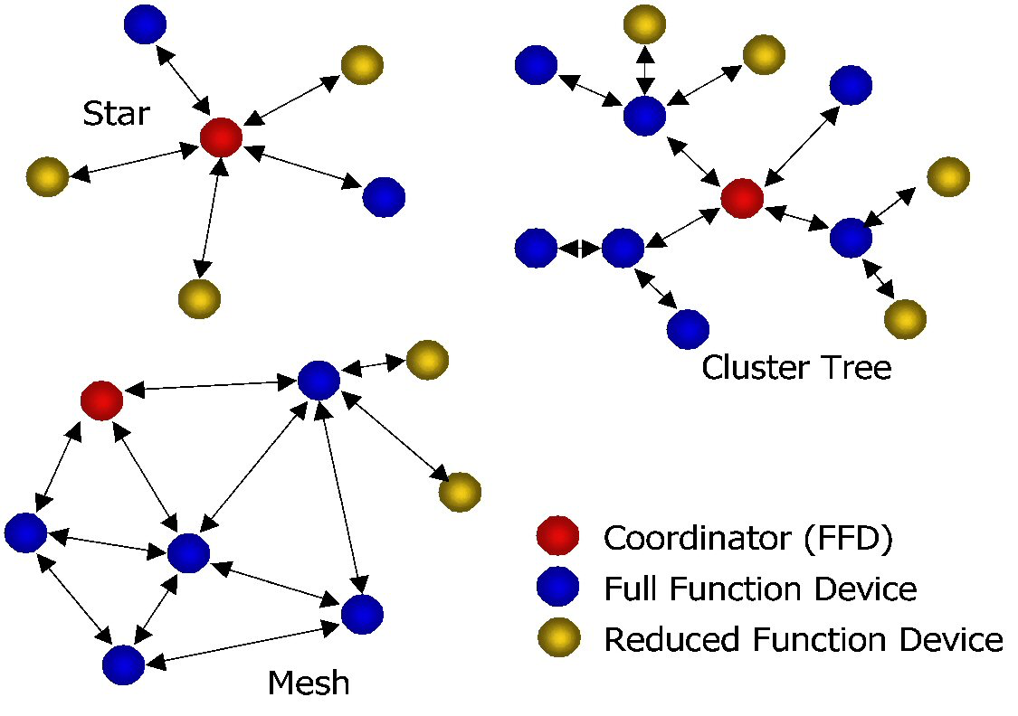
Wireless Topologies

Slide 10
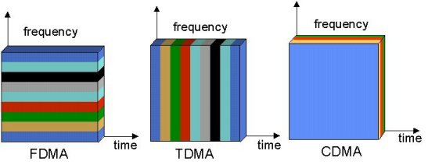
Wireless Channel Dimensions
Time
Frequency
Coding
Space (Directional Antennas)
space
space
space

Slide 11
ALOHA
Node 1 Packet
Waiting a random time
Node 2 Packet
Retransmission
Retransmission
1
2
3
3
2
Time
Collision
Node 3 Packet
Collision mechanism in ALOHA

Slide 12
Carrier Sense Multiple Access (CSMA)
Node 1 Packet
Node 5 sense
Node 2 Packet
Node 3 Packet
Delay
1
2
3
4
5
Time
Delay
Collision
Node 4 sense

Slide 13
What about power?
Typical Low-Power Radio Power States (802.15.4)
Idle: 426 µA
Power Down: 20 µA
Voltage Regulator Off: 0.2 µA
TX: 17.4mA
RX: 18.8mA
TX
860 μS
2 μS
Sleep
Idle
RX
* All currents at 3 volts

Slide 14

Radio + CPU Power
2,870 mAH (@ 25ma) 1.5v x 2 (series)
Active: 7 mA → 17 days
Active + TX: 24.4 mA → 4.9 days
Active + RX: 28.8 mA → 4.6 days
Idle: 2 mA → 60 days
Sleep: 70 µA → 4.68 yrs!

Slide 15
Low Power Listen (LPL)
Check Interval
Radio RX
B
Radio TX
Radio RX
A
Radio TX
Sampling Interval

Slide 16
LPL-CSMA
Radio RX
Radio TX
Listen Frequently
Radio RX
Radio TX
Transmit Longer

Slide 17
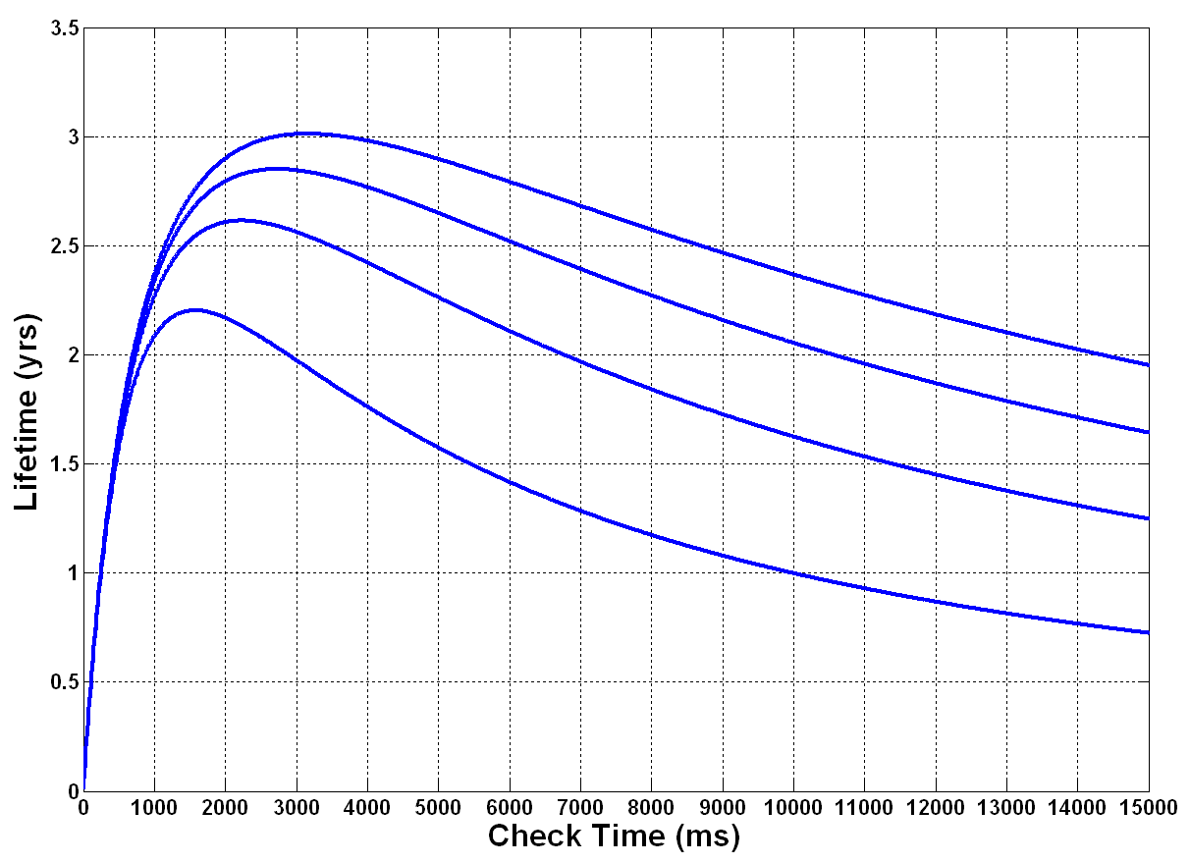
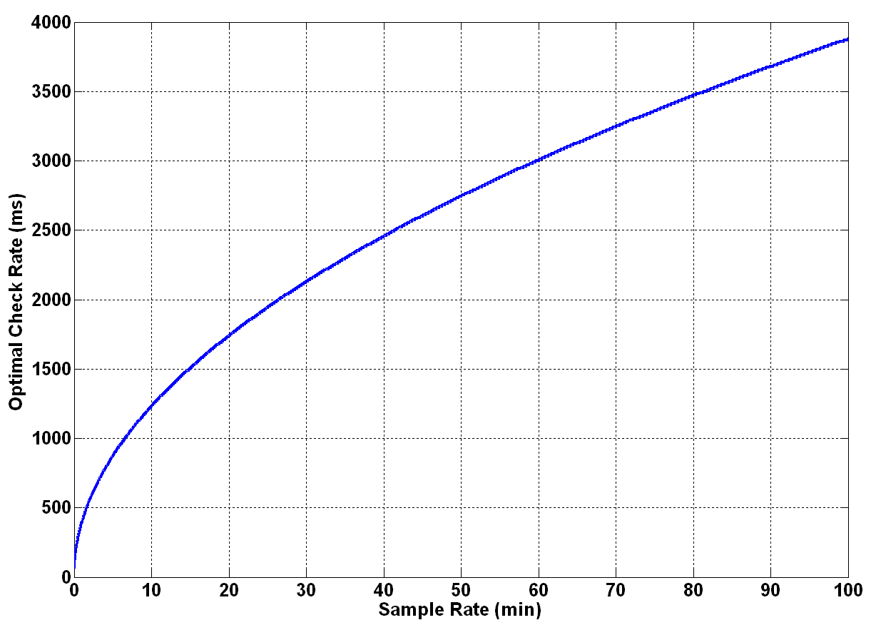
LPL-CSMA
Multiple Sampling Intervals
60 min
Life (yrs)
40 min
Optimal Check Interval (ms)
30 min
20 min
Check Interval (ms)
Sampling Interval (min)

Slide 18
TDMA-Based Approach
Time-Sync Cycle
Frame (32 per TDMA Cycle)
Sync Pulse
Sync Pulse
Scheduled Slots
Contention Slots
32 Slots Per Frame

Slide 19
TDMA Graph Coloring
“Color” Topology Graph to Avoid Collisions
Each color represents a TDMA slot
a
TX
RX
a
Gateway
a
d
TX
d
b
c
c
RX
f
f
b
b
e
e
d
d
TX
c
RX
TDMA Frame

Slide 20
Wireless Technologies
How do you integrate wireless into an embedded system?
What are the tradeoffs?
Common Technologies:
IrDA
NFC
802.15.4
Zigbee
Bluetooth
Low-Power Wide Area Networks
WiFi
LTE

Slide 21
Communication Trade-offs
WiFi, Celluar, Ethernet
Performance
(bandwidth, range, etc)
802.15.4, BLE, CAN
UART, I2C, SPI
Cost
($$$, power, complexity, etc)

Slide 22
ISM Band
Industrial, Scientific and Medical (ISM) radio bands
Unlicensed Spread Spectrum
Multiple frequencies: 900MHz, 2.4GHz, 5.8Ghz, …
A few bands are accepted world-wide…

Slide 23
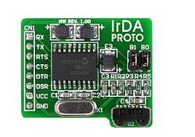
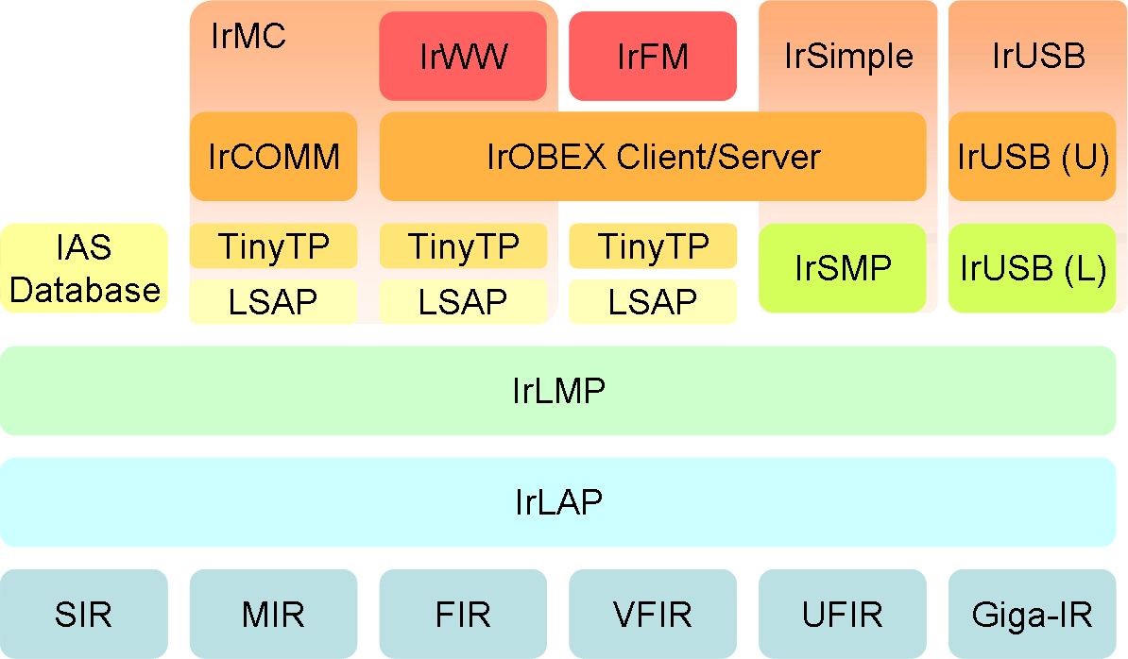
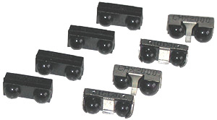
IrDA
Uses Infrared light
Appliance Remote Control
Super Cheap / Easy to Build
Typically 9600 baud (up to Mega Baud)

Slide 24
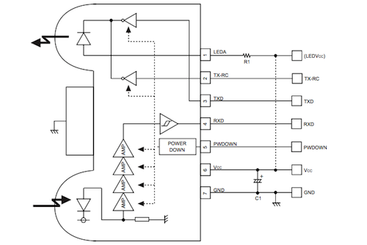
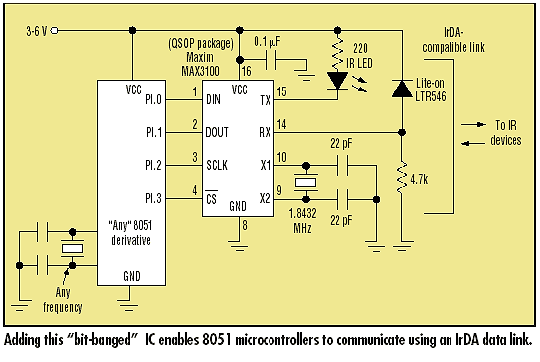
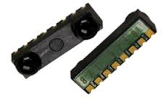
IrDA Transceiver

Slide 25
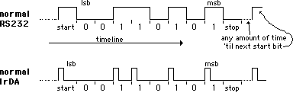
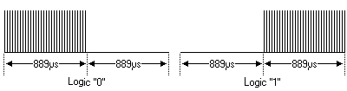
IrDA Modulation

Slide 26
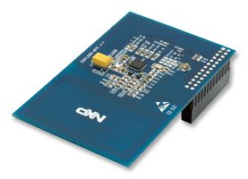
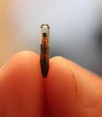
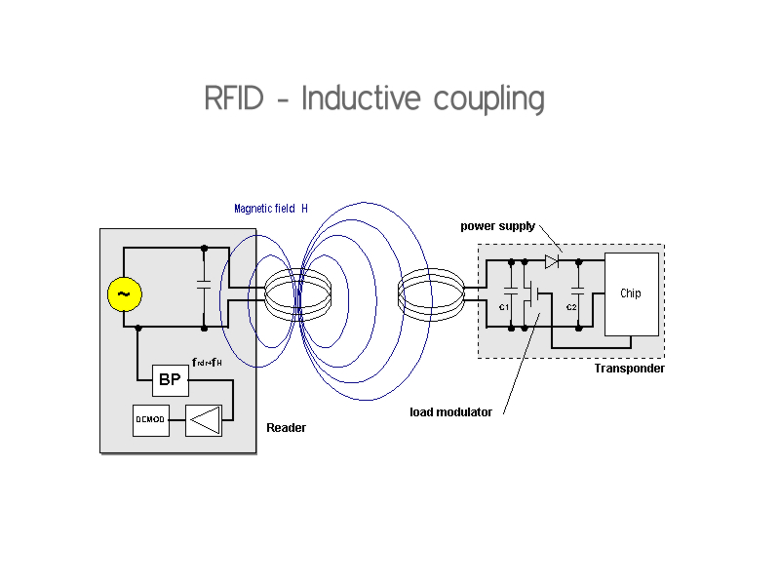
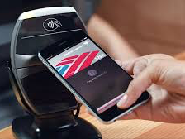
Near-Field Communication (NFC)
Used in mobile payment
Short Range
RF inductive coupling
Send power for receiver
Low-Cost Receiver
Expensive Transmitter

Slide 27
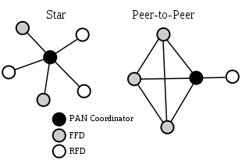
802.15.4
Physical Layer for Zigbee, ISA100.11a, WirelessHART, 6LoWPAN
Mesh Wireless
2.4GHz, 16 channels, 250 kbits/s
Comparison to WiFi
Similar range
Lower data rate
Lower power

Slide 28
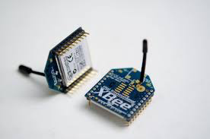
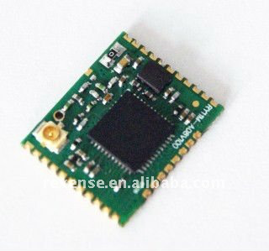

802.15.4
Modules with Serial AT command Interface
SoC with Microcontroller
Approximate Energy
1.8v
20mA RX
20mA TX
4ms max packet time

Slide 29
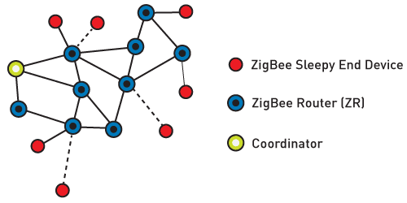
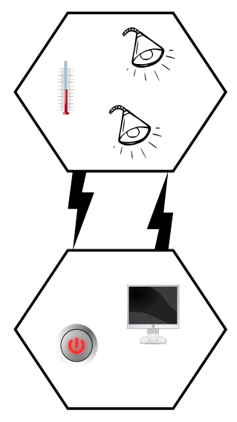
Zigbee
Built on 802.15.4, but adds:
- Routing
- Security
- Duty-cycling
- Application Specs

Slide 30

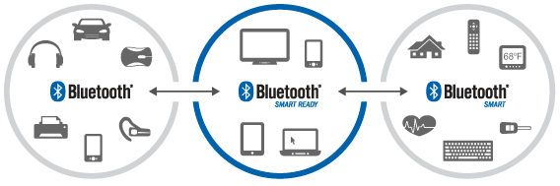
Bluetooth
Designed as Cable Replacement
2.4 GHz, 10-60m range, 3 Mbit/sec
Version 1-2
Big, slow, complicated
Version 3-4
24 Mbits/s
BLE (bluetooth low energy)

Slide 31
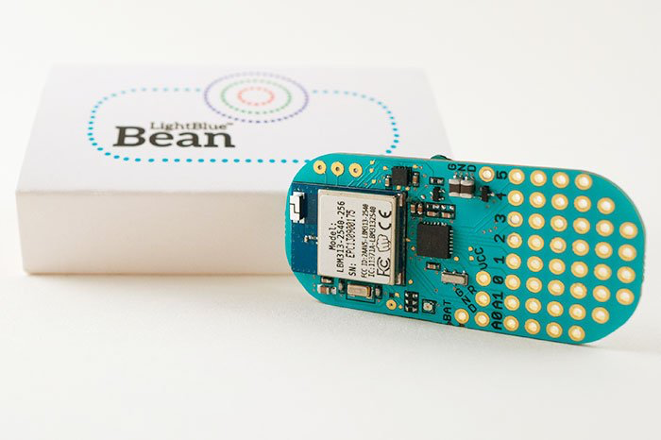
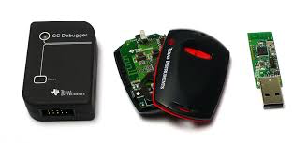
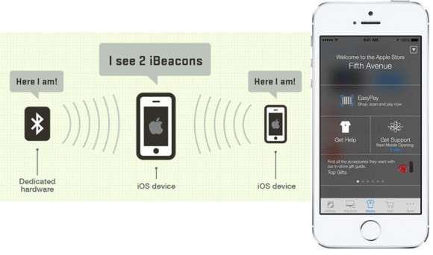
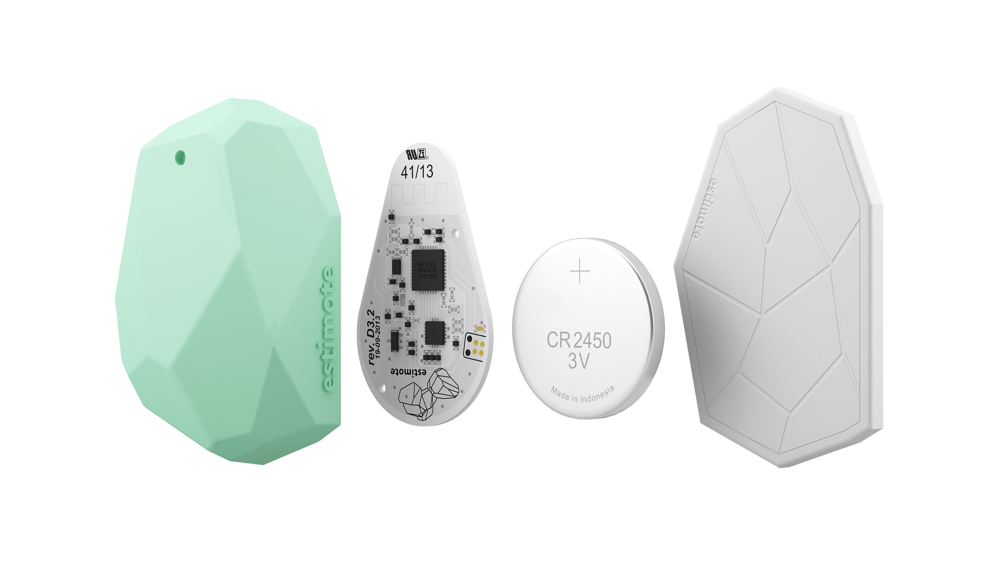
Bluetooth Low-Energy
TI CC2540 BLE chipset

Slide 32
WiFi
802.11 a,b,g,n,p,ac,…
Typically 2.4 and 5 GHz
100m range and up to 600 Mbit/s
60GHz 802.11ad 7 Gbit/s
High-speed Ethernet replacement
Power hungry (can be duty-cycled)

Slide 33
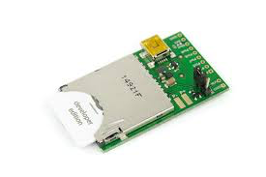
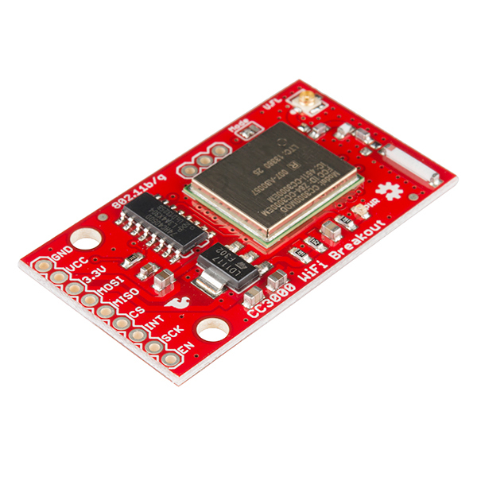
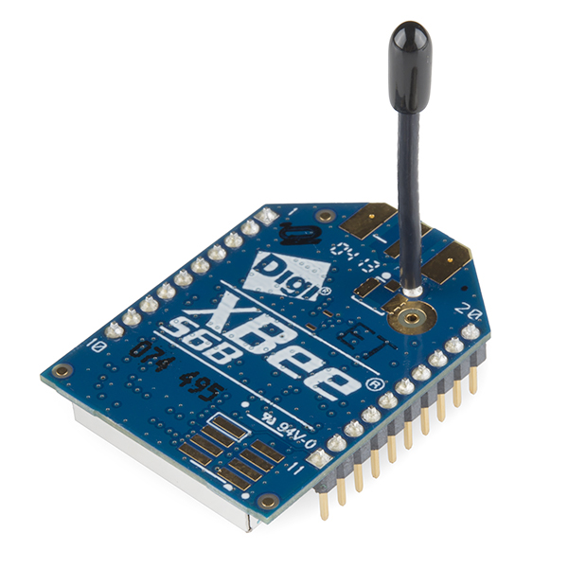
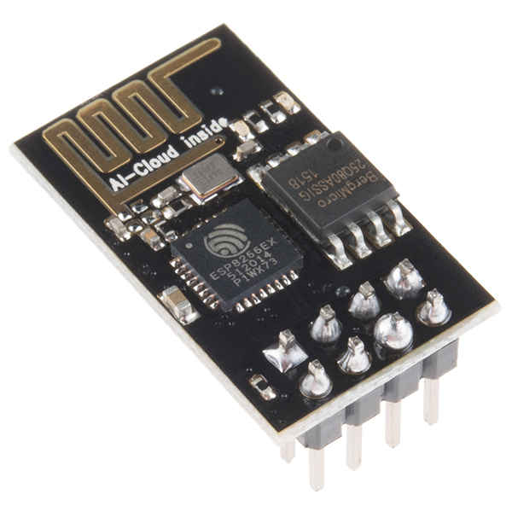
WiFi Interfacing
Electric IMP
(cloud solution)
Xbee Wifi Module (UART)
TI CC3000 (SPI)
Approximate Energy
3v
100mA RX
150mA TX
<4ms MTU packet time
ESP8266 (SPI)

Slide 34
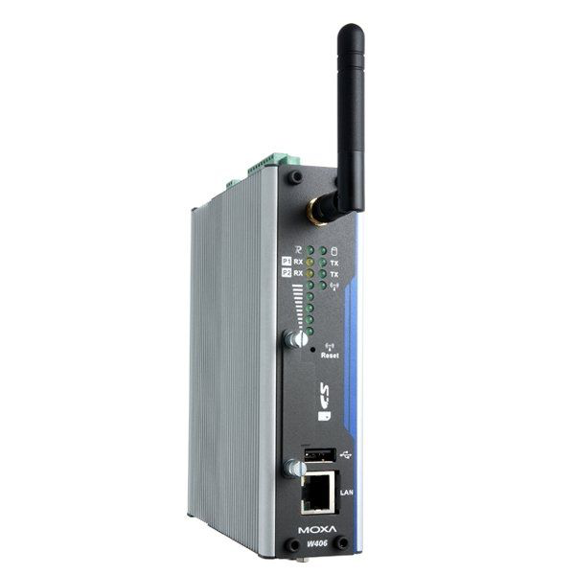
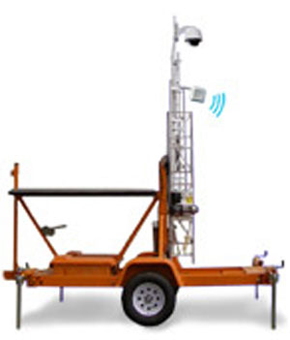
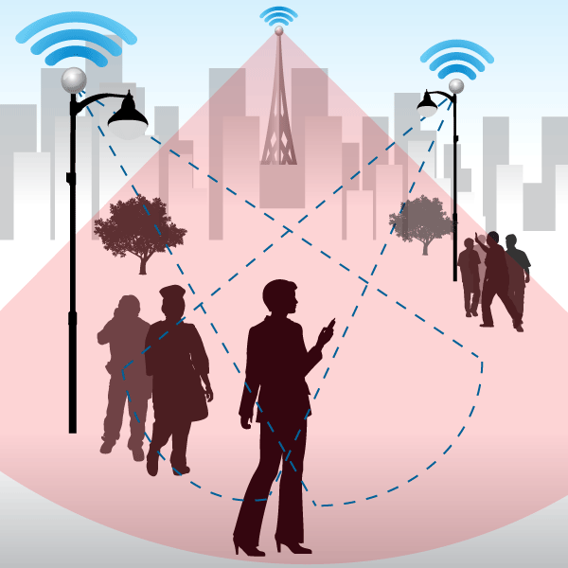
GSM / LTE
Cellular is pervasive
Good for remote monitoring
Can be expensive for a single device
Telemetry plans are available

Slide 35
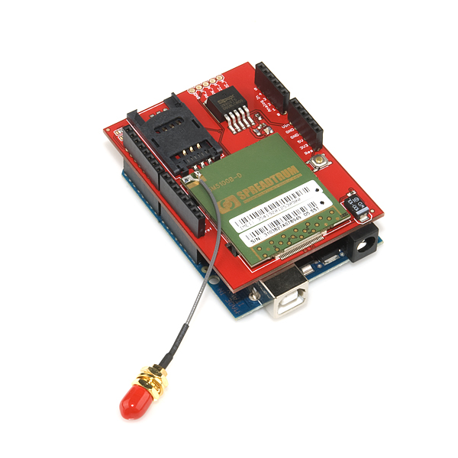
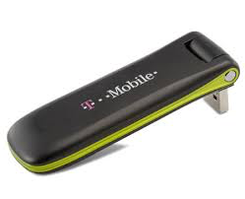
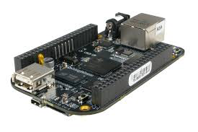
GSM / LTE options
Spreadtrum SM5100B (UART)
Approximate Energy
3.3v
350mA RX
2000mA TX

Slide 36
Low-Power Wide Area Networks (LP-WAN)
Pervasive network for IoT devices
Battery powered client devices
Easy-to-use and secure
Large-Scale 10K+ devices
Open to CMU community…
Why LP-WAN?
Cellular solution are expensive in terms of both hardware and contracts…
Not optimized for long-term battery-operated devices…
Coverage of reomte areas

Slide 37
Why now?
WiFi and LTE have pushed radio performance…
Great sensitivity
Great power envelope
Advanced modulation at a low cost
LP-WAN Explosion
Narrowband radios: LoRa, LTE-MTC, SigFox...
We are borrowing from all of the technologies...
Trade-off speed for range and power
WiFi: 10-300 Mbps at 100m
LoRa: 0.3-50kbps at 15km (2km urban)

Slide 38
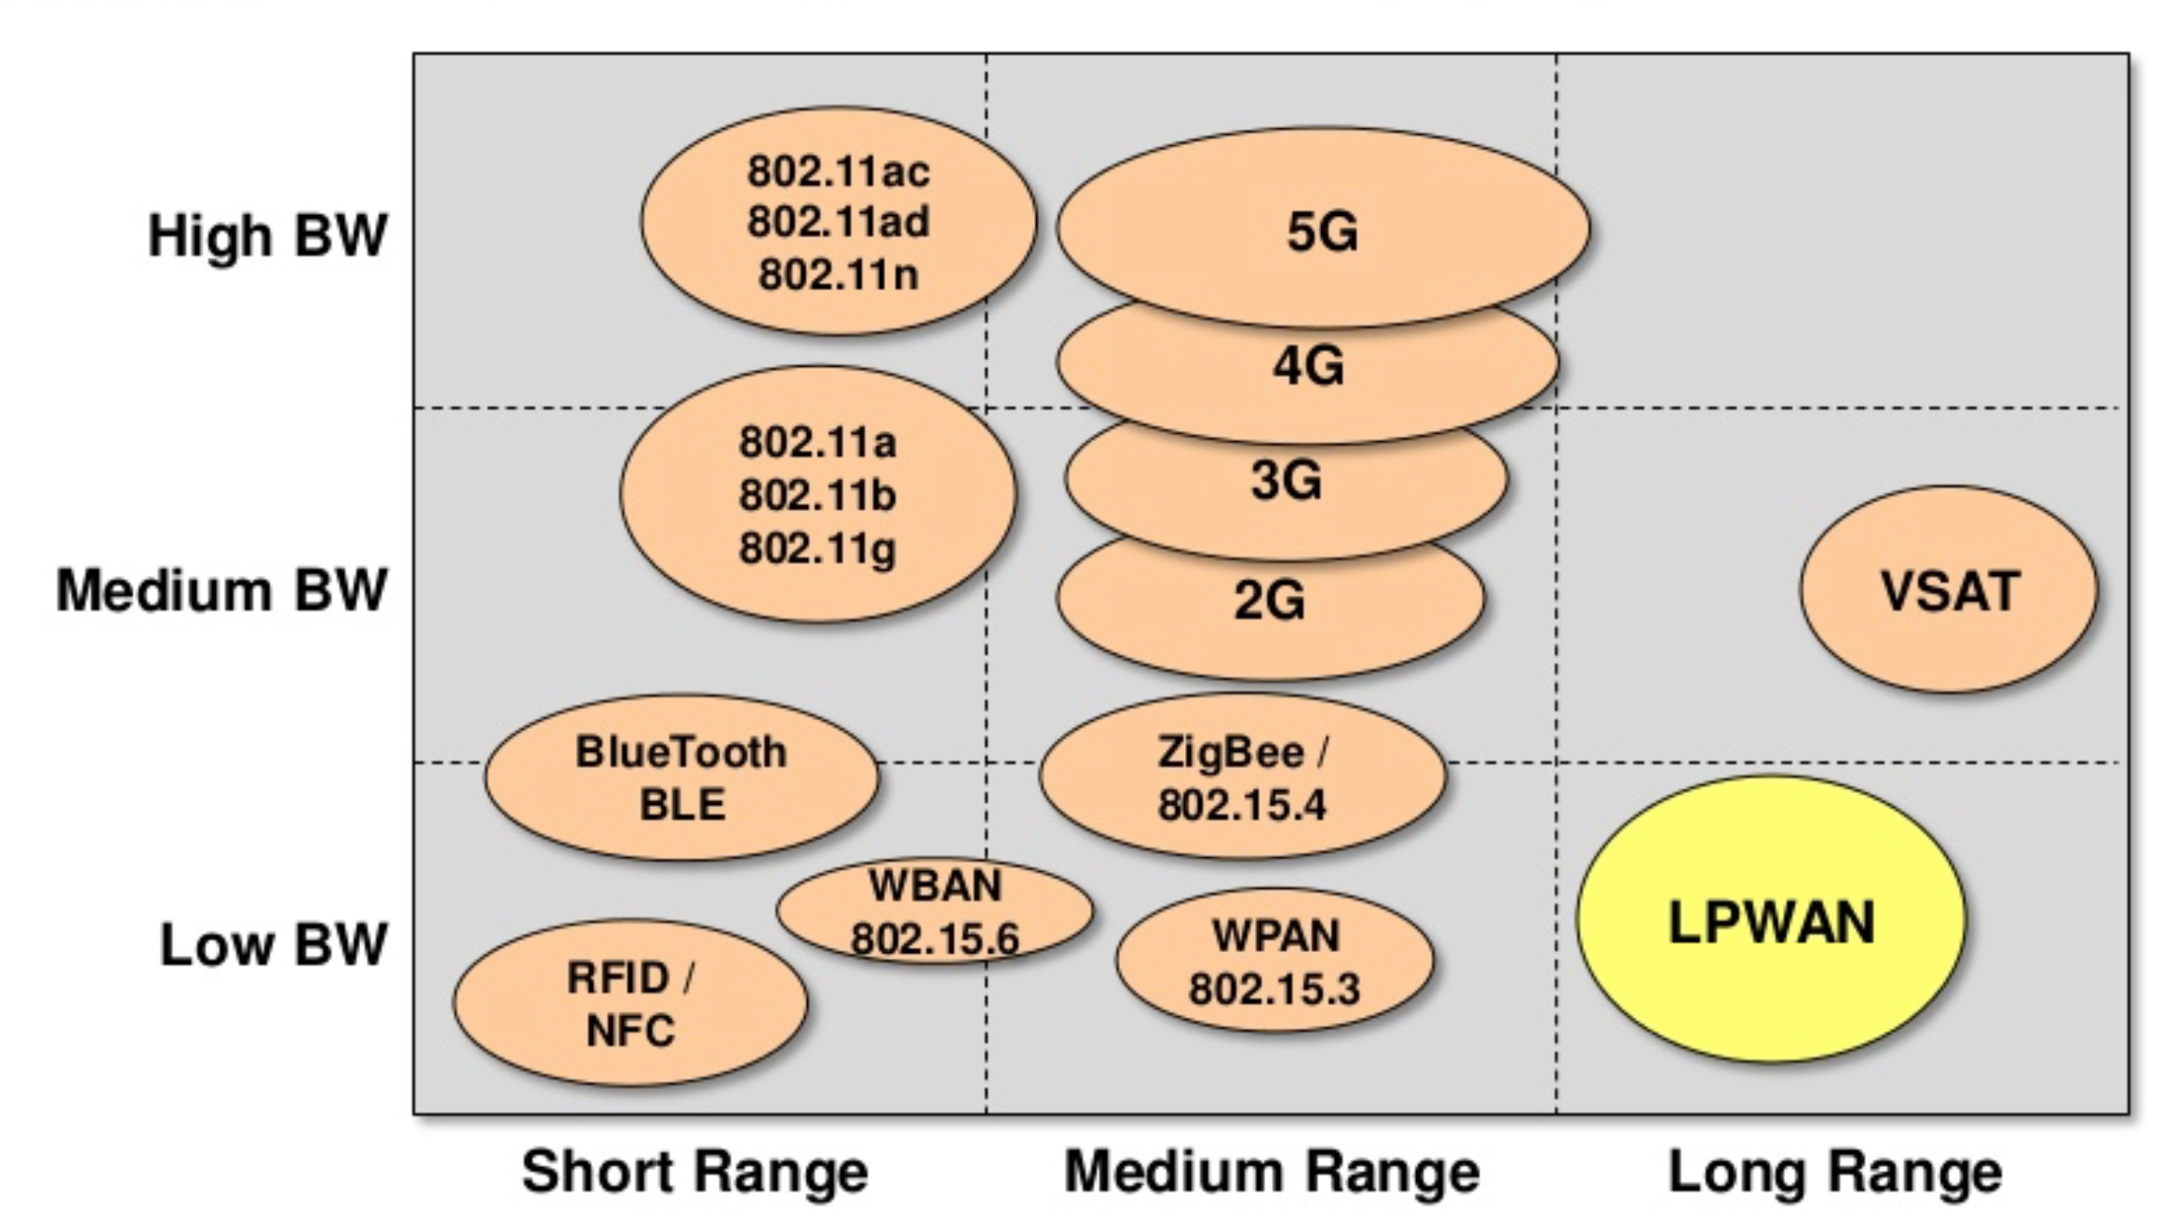
Wireless Space for IoT (1-2)

Slide 39
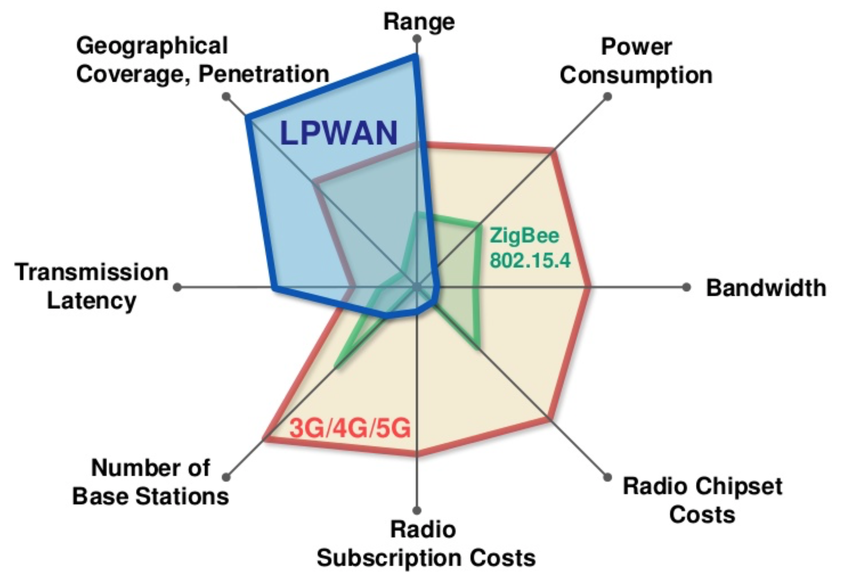
Wireless Space for IoT (2-2)

Slide 40
LP-WAN Technologies
LoRA
<1GHz Chirp Spread Spectrum
“Open”
Semtech chipset
LTE-MTC
<1GHz Narrow Band LTE
SigFox
<1GHz power amplified 802.15.45
Proprietary

Slide 41


The OpenChirp Project Open and Secure Low-Power Wide Area Networking

Slide 42
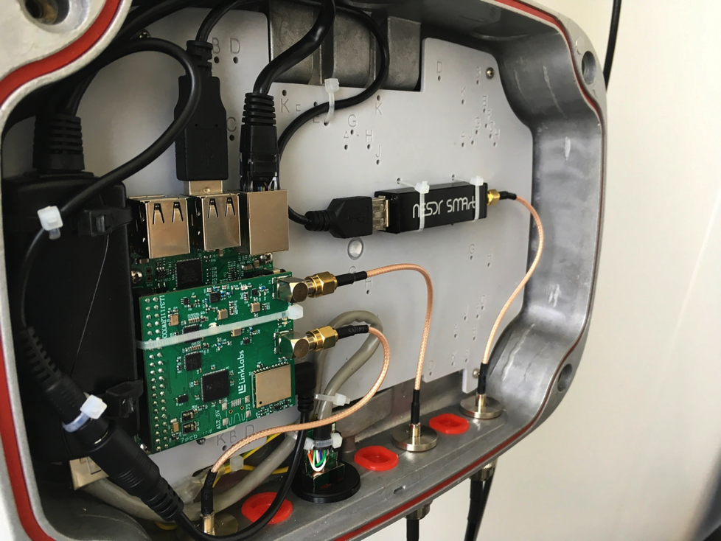
Concentrator Hardware Prototype
Low Cost SDR
PoE Supply
Embedded Linux
GPS
Custom LoRa Gateway (40K+ clients per gw)

Slide 43
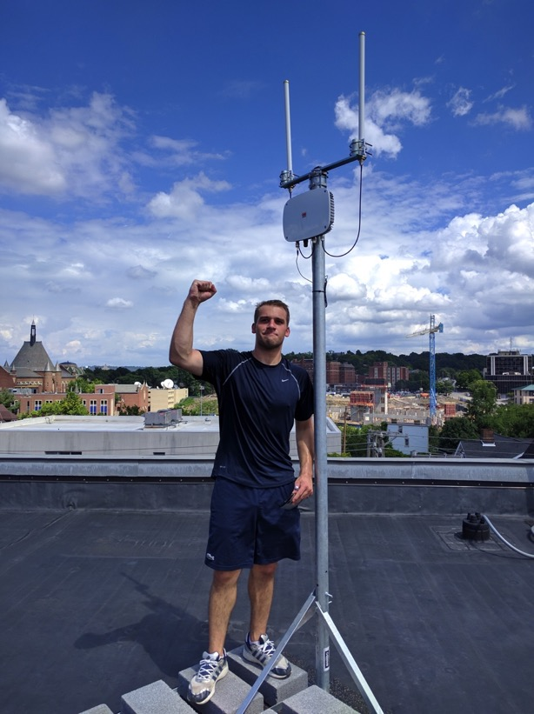
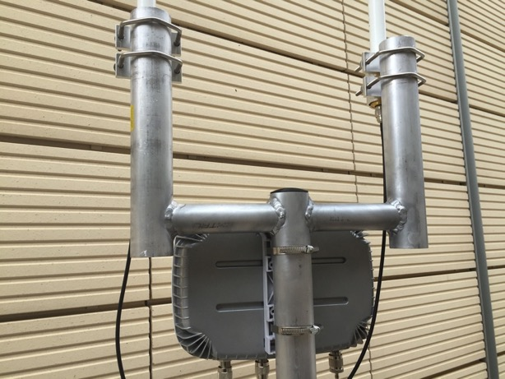
Concentrators
Independent 1-λ separated 5.5dBi 902MHz ~ 928MHz antennas with grounding rod (custom assembly)

Slide 44
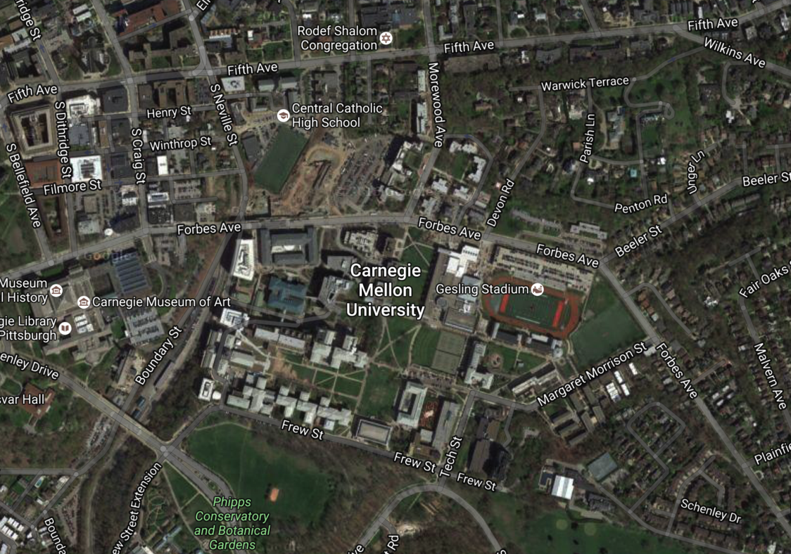
CMU Campus Locations

Slide 45
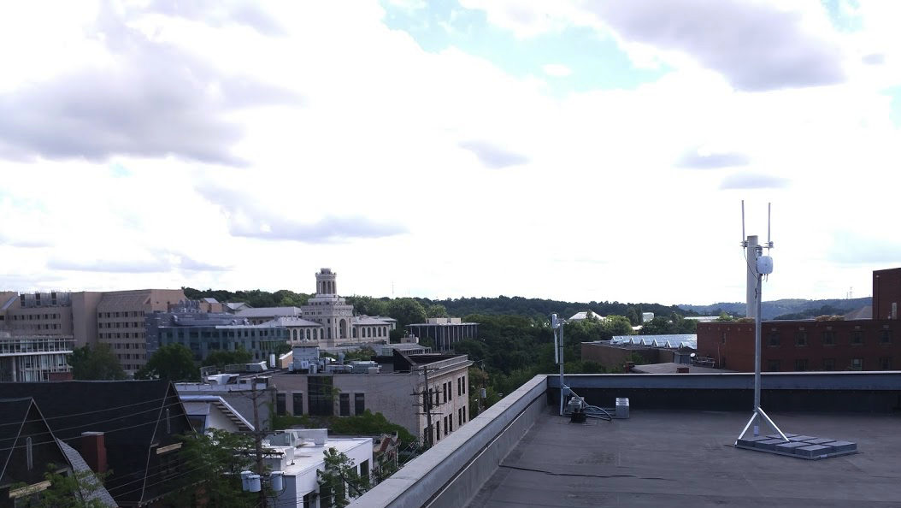
Craig Street Aggregator

Slide 46
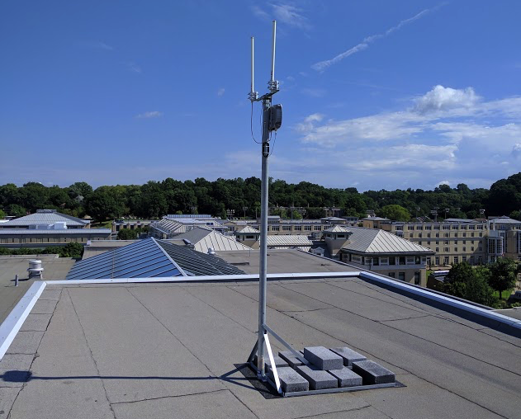
Tepper Aggregator

Slide 47
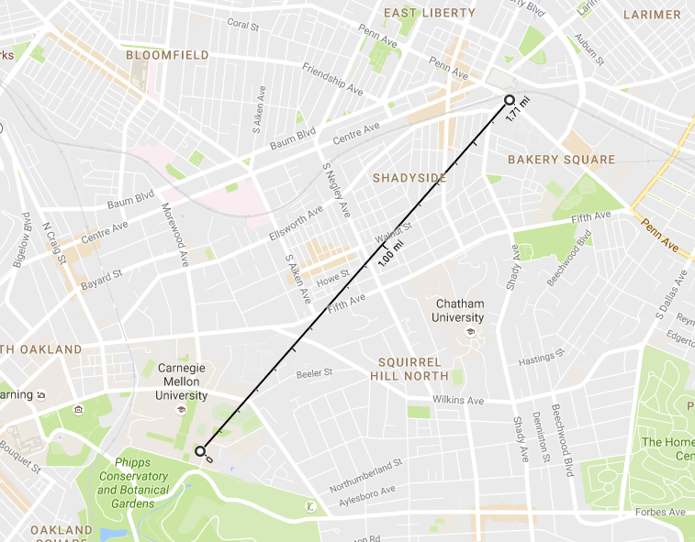
Serious Range…
Rooftop to Indoor Packet Reception at 1.7miles!

Slide 48
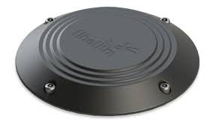
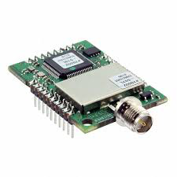
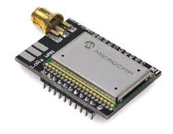
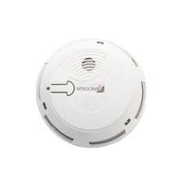


Commercial LoRa Clients
Many commercial devices already coming onto the market…
Street Sensor
Citizens Science Kits
Smoke Detector
Key Fob
Temperature Sensor

Slide 49


LoRa Bug Custom Client
TI CC2650 ARM M3
BLE + 802.15.4
FireFly
Sensor Header
SX1276
LoRa Radio
USB
Sensor Board: Light, Temperature, Accelerometer, Magnetometer, Rate Gyro, Humidity, Water Contact, Pressure, Audio, PIR motion

Slide 50










OpenChirp Concept
Step 1: Setup an account
Step 2: Grab a LoRa Device
Step 3: Configure Devices
CoAP
AMPQ
ReST
MQTT
XMPP
Step 4: Deploy the device
Step 5: Manage Devices
Sounds easy, but there is a lot that needs to be done under the hood…

Slide 51
Conclusions
Lots of activity in the wireless space right now
Many options for integration into embedded systems
Many trade-offs between power / cost / complexity
Next Class: Embedded Security

